Slide 1
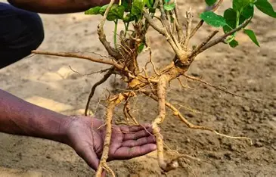
Bioclimatic Suitability & Spatial Profiling
Ecological Modeling of Withania somnifera
A Universal R Pipeline for Precision Agriculture
Priyanshu Gupta
Department of Botany, DBS (PG) College, D.dun, Uttarakhand

Slide 2
PROBLEM STATEMENT & MOTIVATION
The Dual Crisis in Medicinal Plant Conservation
1. Over-Harvesting🪓
2. Climate Shift 🌡️
3. Precision Gap 🗺️
80%+ wild extraction leads to genetic depletion
Temperature spikes alter active plant yield
Lack of spatial mapping for data-driven farming
THE SOLUTION: Automated R Macro-Ecological Pipeline for target farming

Slide 3
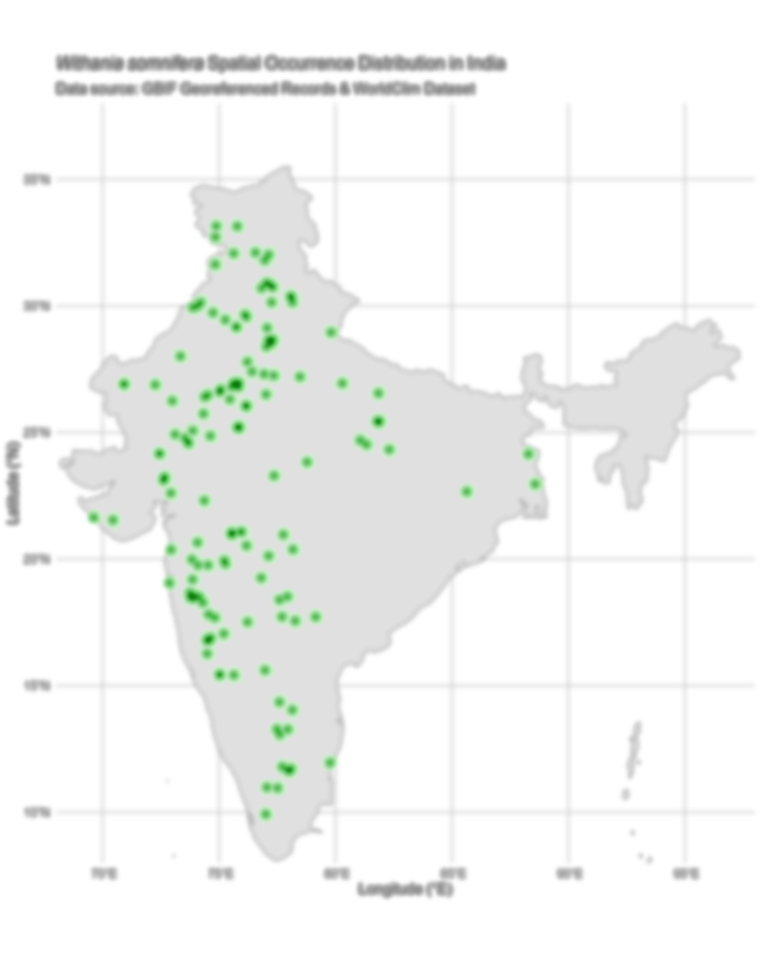
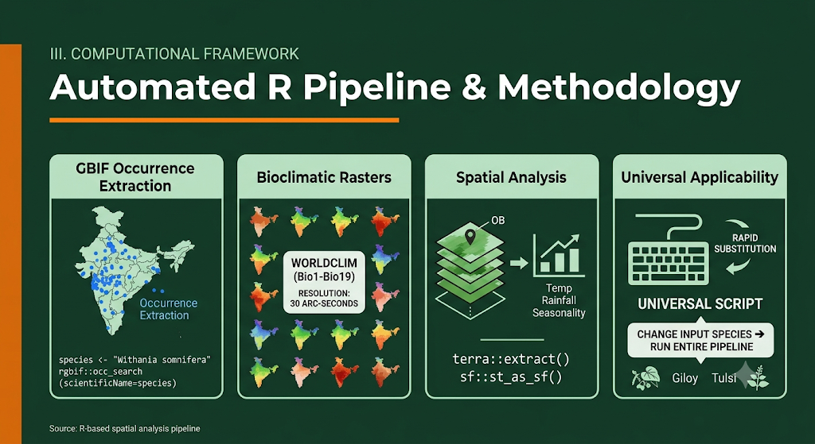
Computational framework
Automated R Pipeline & Methodology
GBIF occurrence extraction
Bioclimatic rasters
Spatial analysis
Universal applicability

Slide 4
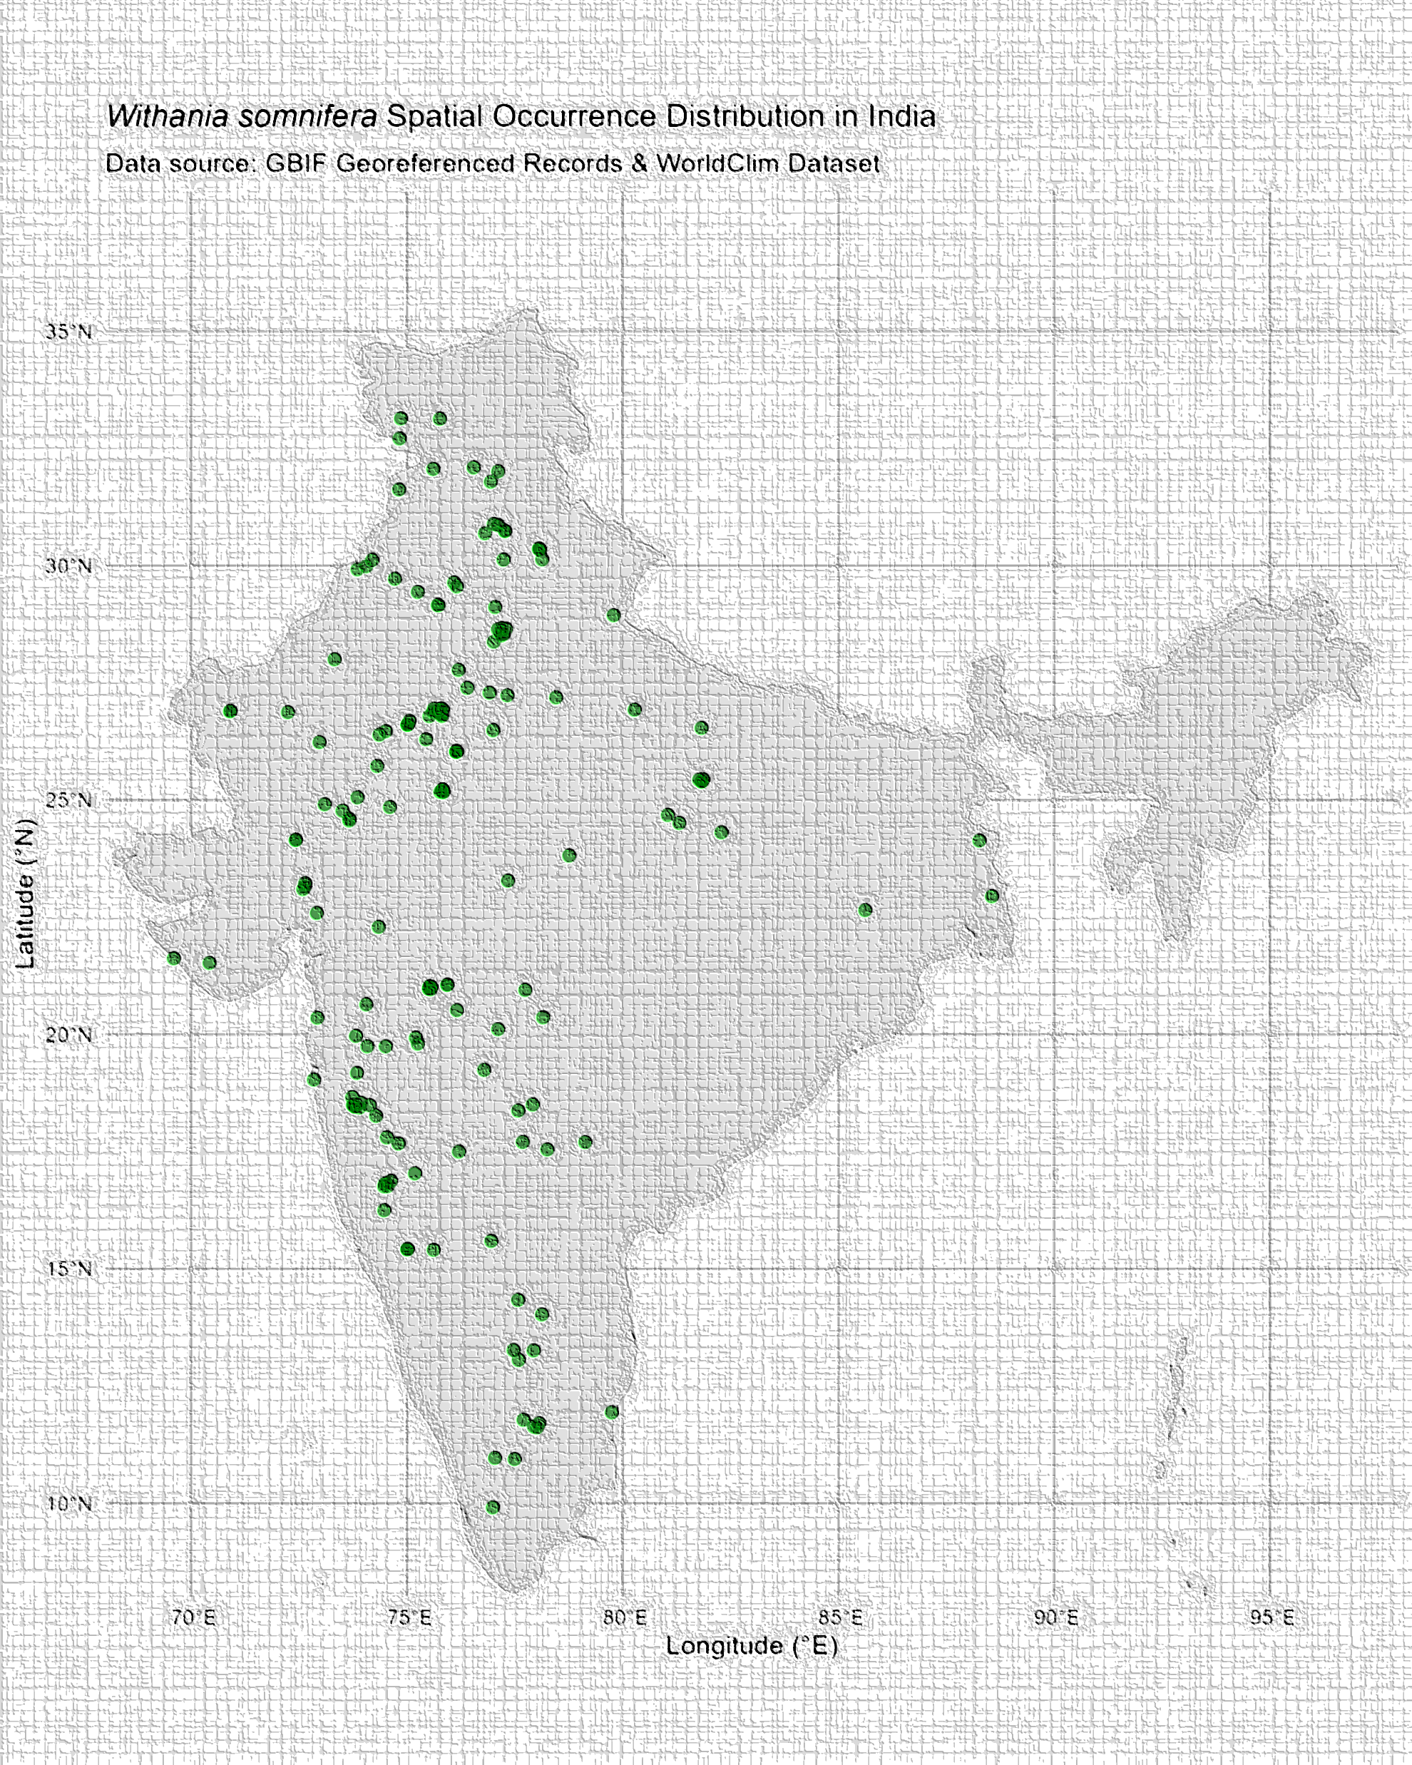
Result & bioclimatic drivers

Slide 5
ECOLOGICAL NICHE & CLIMATE SENSITIVITY
1. THERMAL & HYDROLOGICAL BOUNDS Envelope (Bio1) Temperature: Optimal suitability peaks tightly at 24–28°C. Frost and sub-15°C regimes suppress growth. Moisture Constraint (Bio12): Core niche relies on 600–900 mm annual precipitation. Excess rainfall induces root rot & disease. | 2. GEOGRAPHIC & ELEVATIONAL CONSTRAINTS High-Altitude Exclusion: Cold stress in Himalayan regions limits Bio6 (Min Temp of Coldest Month). High-Precipitation Exclusion: Excessive humidity in Western Ghats & East promotes fungal vulnerability and root rot.
KEY ECOLOGICAL INSIGHT
Withania somnifera functions strictly as a xerophilic/semi-arid specialist across India.

Slide 6
APPLICATION
Agriculture Zoning & Climate Resilience Framework
Commercial Agricultural Zoning Priority Farming Clusters Rajasthan, Madhya Pradesh, Gujarat, & Deccan Plateau. Natural climate alignment reduce artificial irrigation cost. Soil & Drainage Management Select sandy loam to well-drained light red soil. Avoid low-lying clay soils to mitigate root decay risks. Harvest Timing Optimization Time root harvesting following post-monsoon drying to maximize active withanolide concentration. | 2. Conservation & Climate Vulnerability Wild Germplasm Protection In-situ conservation required in marginal ecotones. Prevent over-exploitation of high-quality wild stocks. Shift Under Warming Scenarios Rising temperatures may push suitable niches northward into transitional climatic zones.
STRATeGIC IMPACT
Guides site selection for commercial cultivation while SAFEGUARDING GENETIC BIODIVERSITY AGAINST CLIMATIC SHIFT.

Slide 7


Key Takeaways & Outlook
CONCLUSION
LIMITATION
FUTURE WORK
3. Integrate SoilGrids & Conduct Field Ground-Truthing
2. Climate Models Omit Local Soil & Waterlogging Risks
1. Universal framework: modeling species, conservation & agriculture

Slide 8
Acknowledgements
BOTANY DEPARTMENT
THANK YOU
GRATITUDE TO OUR TEACHERS
Thank you to everyone in attendance for your time, attention, and valuable feedback.
Questions and discussion are welcome!
I would like to express my sincere gratitude to the faculty and mentors of the Department of Botany for their invaluable guidance, academic support, and insights throughout this study on Withania somnifera.

